Slide 2


DMU
Hacking Society
Reverse Engineering

Slide 3




DMUHACKERS
D0nt d0 1ll3gal sh1t
please..

Slide 4

DMU HACKERS
Announcements
Get your teams signed up for P2P – May 30th!
https://dmuhackers.com/
QOTD: Favourite Song?

Slide 5

What is Reverse Engineering?
The process of analysing systems and software to understand how it works, how it is structured, and reconstructing data from binary artifacts
C/C++ traditionally the focus programming languages, but the reverse engineering process applies to other languages (Go, Rust, OCaml etc).
Split into two main analysis types: Static and Dynamic
Use cases:
Vulnerability research - finding zero days in software before release
Malware analysis - understanding and extracting indicators of compromise
CTF competitions
Bug bounties – finding logic flaws in compiled software
Software testing

Slide 6

From source code to Binary
Compilers are used to transform human-readable code into machine code. Reverse engineering operates this pipeline backwards.
Compilation pipeline for C programs
Preprocessing
Compilation
Assembly
Linking
What can get lost along the way:
Variable and function names
Code comments, type info, and code structure
Notes:
There are 4 key stages of the compilation pipeline
C is a mid-level language which needs a compiler to convert it into executable code so that the program can actually be run

Slide 7
Preprocessing (.c -> .i)
The preprocessor runs first, think of this stage as a text-rewriter that prepares files before the compiler even sees it.
Purpose
Strips out comments
Substitutes object-like macros
Inlines function-like macros
Pastes the full text of every header file in place of each #include directive
Selects only one branch of conditional directives and discards the rest (#ifdef, #else)
Outputs a single flat .i file
From a RE perspective:
Macros and #defines are gone/ leave no trace in the binary
Comments do not exist downstream
Library types and constants now merge with regular code
Conditional branches that weren’t compiled are invisible

Slide 8
Compilation (.i -> .s)
The compiler turns preprocessed C into assembly. This is where most information is lost
Purpose
Lexical analysis - splits source text into tokens (keywords, identifiers, literals, operators)
Syntax analysis – parses tokens into an abstract syntax tree (AST)
Semantic analysis – catches undeclared variables, type checking
Optimisation – register allocation, inlining, code elimination, etc
Intermediate Representation is emitted as a target-specific assembly text (.s file with x86 architecture /ARM etc)
From a RE perspective:
This is where decompilers live – Ghidra, IDA Hex-Rays, retdec etc
Macros and #defines are gone/ leave no trace in the binary
Comments do not exist downstream
Library types and constants now merge with regular code
Conditional branches that weren’t compiled are invisible
The decompilation is a starting point, cross-check with disassembly as the output will vary
Notes:
.s file in assembly level instructions

Slide 9
Assembly (.s -> .o)
The assembler converts human-readable assembly into machine code bytes, which produces a relocatable object file.
Purpose
Translates each mnemonic back into its opcode (mov, eax, 0 becomes B8 00 00 00 00)
Resolves local labels and short jumps into relative byte offsets
Lays out sections - .text(code), .data(initialized globals), .bss(zeroed globals), .rodata(constants)
Leaves external calls unresolved such as printf()
Output is a relocatable object file (.o,linux/ .obj, win) – cannot be run yet
From a RE perspective:
The disassembler sits here – objdump –d, IDA, Ghidra, radare2
Can be difficult to distinguish code from data, especially in stripped or obfuscated binaries
Object files are easier to analyse than full executables
Symbols are often still present

Slide 10
Linking (executable)
The linker stiches object files together, resolves calls to library functions, and produces the final PE/ELF/Mach-O binary that you can run.
Purpose
Takes one or more object files and merges their sections into a single output file
Patches up each relocation entry that the assembler leaves behind, which brings back final addresses
Static linking – copies the full library code into an executable
Dynamic linking – records the library name and symbol, which gets resolved by the OS at load time, only the names of the shared libraries are added to the code which is referred during execution
Writes out the final container format (PE/ELF/Mach-O) with section permissions and an entry-point address
From a RE perspective:
Imports table (PE) / dynamic section (ELF) tells you which libraries are used
Statically linked code is mixed in – FLIRT signatures from IDA or Lumina can be used to identify it
Packers like UPX wrap everything in an extra unpacking stub at link time

Slide 11
Compiling and linking a C program
# Compile source code into an object file
gcc -c example.c -o example.o
# Link the object file to create an executable
gcc example.o -o program
# Run the executable
/program
# All intermediate files will be saved in the same directory along with the executable
gcc –Wall -save-temps example.c –o example
Notes:
This is just an example of how to compile and link a simple C program to show the compilation process
-Wall just enables all the compiler’s warning messages

Slide 12
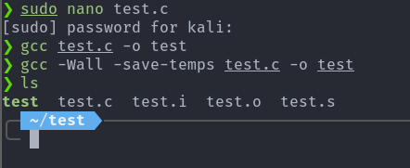
Notes:
As you can see it has created the intermediate files,
Source file (.c)
Preprocessed source (.i)
Compiler generated disassembly (.s)
Relocatable object file (.o)

Slide 13
Binary File Formats
Every executable is wrapped in a container that tells the OS how it should be loaded and ran, knowing the file format is the first step.
Formats
PE (Portable Executable) – Windows.exe,.dll, .sys
ELF (Executable and Linkable Format) – Linux binaries and shared objects
Mach-O – macOS and iOS executables
What to look out for:
Headers
Sections
Imports/Exports
Symbols, relocation (if not stripped)
Notes:
Quick triage tools: File, objdump, readelf, CFF Explorer

Slide 14
Static vs Dynamic Analysis
STATIC ANALYSIS
Examining code without executing it
Disassembly
Decompilation
String analysis, imports and exports
DYNAMIC ANALYSIS
Running and observing the program live
Setting breakpoints, stepping through code
Inspecting registers during runtime
Modifying values during execution
Patching memory instructions

Slide 15

X86_64 Assembly Basics
The key to disassembly is to understand how to follow the control flow and data movements itself. You do not need to know or memorise how everything works.
Common registers
RAX – return value, scratch
RDI, RSI, RDX, RCX, R8, R9 – first six function args (linux)
RSP – stack pointer
RBP – base pointer
Common instructions
Mov / lea – move data / load effective address
Cmp + je / jne / jz / jg – compare and conditional jumps
Call / ret – function call and return
Push / pop – stack operations
Xor reg, reg – common for zeroing registers

Slide 16
Tips on where to start
1.Triage
File, strings, hex view
Check for packers (UPX) and signs of obfuscation
2.Static Analysis
Use tools such as Ghidra/IDA, look specifically at imports, strings, and graph view
Find main/entry point, look for function calls, XOR
3.Dynamic Analysis
Run a debugger (gdb/x64dbg)
Set breakpoints throughout certain functions the raise interest/suspicion
Inspect registers and memory addresses
Notes:
Quick triage tools: File, objdump, readelf, CFF Explorer
Document and iterate, the key is often trial and error

Slide 17
Finding Information
Strings
Strings binary | less – look for URLs, error messages, file paths, format strings
Often gives away program purpose
Symbols and imports
Objdump –d –M intel example – disassemble executable sections, intl style mnemonics, show registers as numbers
Hashes and IOCs
Md5sum / sha256sum – sample tracking
VirusTotal – potentially known malware

Slide 18

Reverse Engineering Tools
IDA Static Disassembler
Ghidra Static Decompiler
Radare2 Static Disassembler, Decompiler, Debugger
GDB Dynamic Debugger
X64dg Dynamic Debugger
PDFiD static analysis tool
Pdfparser static analysis tool

Slide 19

IDA free/pro
Interactive Disassembler, Developed by Hex-Rays
Basic Overview
Hex-Rays Decompiler generates pseudocode from the disassembly
Supports x86 (32-bit), x64, ARM, MIPS, PPC architecture
Implements Cross-References (Xrefs) to track where functions and data are called/referenced from

Slide 20
IDA free/pro: Continued
Key Features
Graph view shows the control flow between blocks
Look at functions, rename variables to better understand processes, add comments as you analyse
FLIRT signatures auto identify standard library functions
IDAPython scripting for automation
IDA Pro unlocks more architectures and functionality, scripting, etc (it will cost you an arm, leg and mortgage to get though).

Slide 21
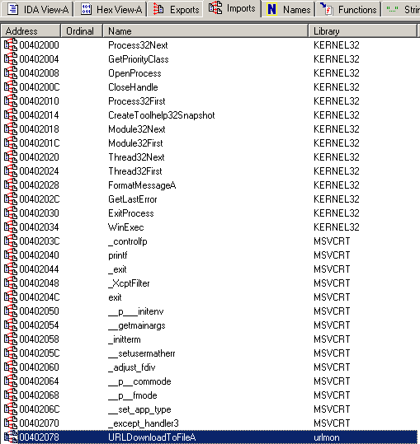
Notes:
Example of looking at imports through IDA, which can be used to find information or indicators of compromise

Slide 22
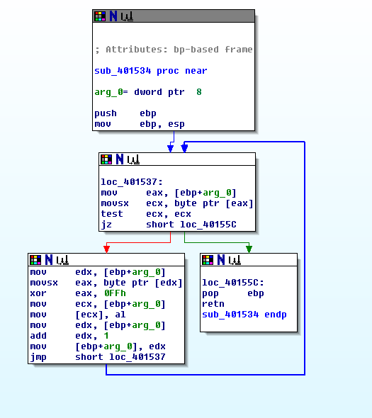
Notes:
This is an example of the graph view using IDA (yes its on windows XP) It just makes the disassembly much easier to read, and shows the control flow process
Towards the bottom of the graph you can see the function looping and the registers getting XOR’d withc what seems to be a key of 0FFh (255 decimal), in this example this key is one of the simplest and predicable XOR operations
As 0xFF flips each bit (0 becomes 1, 1 becomes 0)
h just mean hexadecimal
It is the same as a NOT instruction
Patching binaries can be very useful as it gives you direct control over how a compiled program behaves. It is particularly useful when you do not have access to the source code, allowing you to skip checks, break constants and bypass restrictions.

Slide 23

Ghidra
Open-source reverse engineering tool created by the NSA
Reverse engineers a binary into c code, which can be easier to analyse than assembly language
Often a good starting point before moving onto other tools
‘Ugly’ to use but generally works quite well, at least you don’t have to sell your soul just to use it

Slide 24

GDB
GNU Debugger- standard CLI debugger for Linux, portable across many Unix-like systems. Free
Can be a bit daunting to use at first, but a powerful debugging tool.
Allows you to run programs step by step, and setting breakpoints at specific memory locations to understand how the code works and fix bugs efficiently.
Useful commands:
Break <address/function>
Run, ni – run and step at next instruction level
Info registers, disassemble – inspect state and memory
Set $rax = 1 - patch values in run-time to bypass checks
x/nfu <address> - examine memory at specific address,
list <file>, <line> - Display source code around a specific line
Notes:
/NFU
X=HEX
D=DECIMAL
U=UNIT SIZE (B=BYTE,W=WORD)

Slide 25
PDFiD
Static analysis tool that is used to triage potentially malicious or hidden information within PDF files
What it does
Scans raw PDF structure without opening or executing anything
Safe for first stage static analysis
Useful as it gives a fast indication of whether something is hidden within
Finds embedded scripts (JS) / Files
Nfinds encoded payloads, shellcode etc
Next steps
Object-level inspection tool (pdfparser .py , peepdf) to extract information
Decode and deobfuscate extracted information, inspect flagged objects
Determine what is being targeted, what does the extracted information contain
Notes:
/NFU
X=HEX
D=DECIMAL
U=UNIT SIZE (B=BYTE,W=WORD)

Slide 26
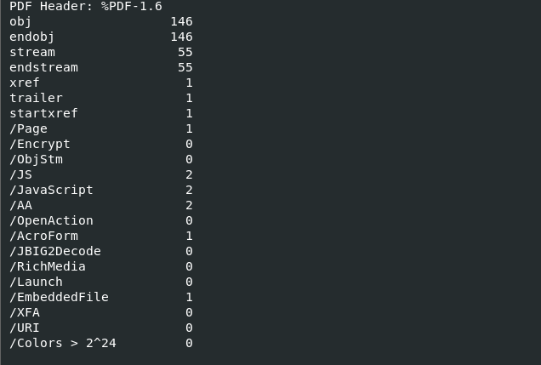
Notes:
You can see the embedded file using pdfid.py
There are in this scenario 2 JS hidden within what seems to be a harmless pdf file

Slide 27

x64dbg
Open-source dynamic debugger for Windows binaries – free alternative to OllyDbg
Beginner friendly
UI easy to use and follow
ships with both 32-bit and 64-bit versions
Has a plugin ecosystem which can be used to extend functionality
Can be paired with other software such as Ghidra/IDA for static
And dynamic analysis synchronisation
Notes:
ScyllaHide-anti debugging plugin
TitanHide- kernal mode anti debug plugin
X64dbgida- synchronises x64dbg with IDA Pro

Slide 28
Anti-Reversing Techniques
In Real-world scenarios, malware, protected software and difficult CTF challenges may often fight back. Learn to recognise these tricks:
Stripped Binaries
Symbols and debug information have been removed
Look towards strings and xrefs to try and piece the puzzle
Obfuscation, Packers
Original code is compressed or virtualised
Unpack at runtime, dump memory after packing
Anti-Debugging, Anti-VM
timing checks, IsDebuggerPresent API function,
VM detection using CPUID, MAC addresses, registry keys, etc
Bypass using plugins, or edit/remove the checks

Slide 29
Practical
There should be two RE samples on the Github
DMU Hackers · GitHub
Refer back to some of the information on the previous slides

